Slide 1
User Journey
ONLOAN APPS

Slide 2
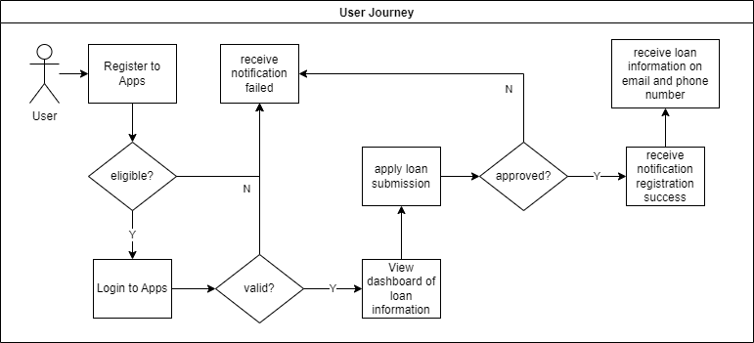
Diagram Flow

Slide 3
Screen Flow Registration to Submission

Slide 4
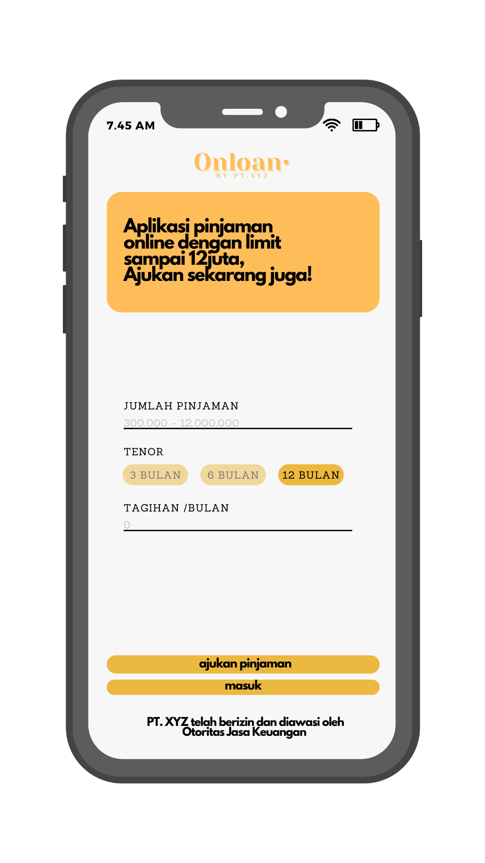
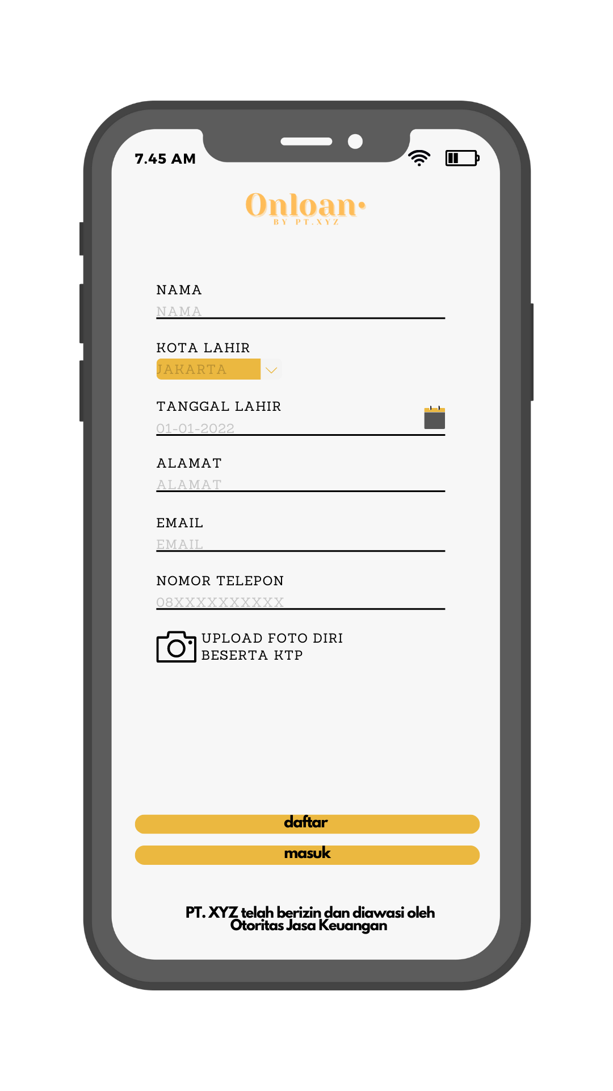
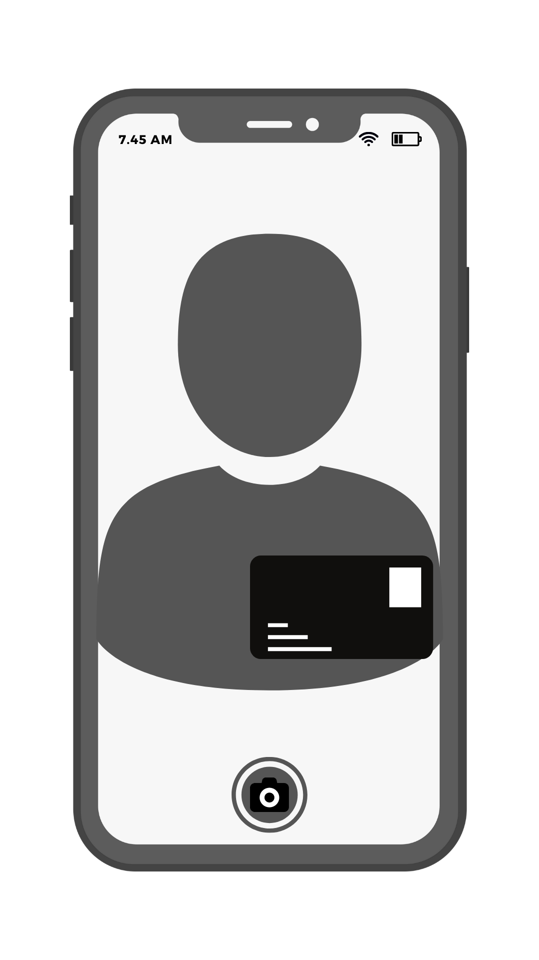
Screen Flow
1. Landing page
2. Registration page
3. Open camera to
Upload self photo with KTP
4. Back to
Registration page

Slide 5
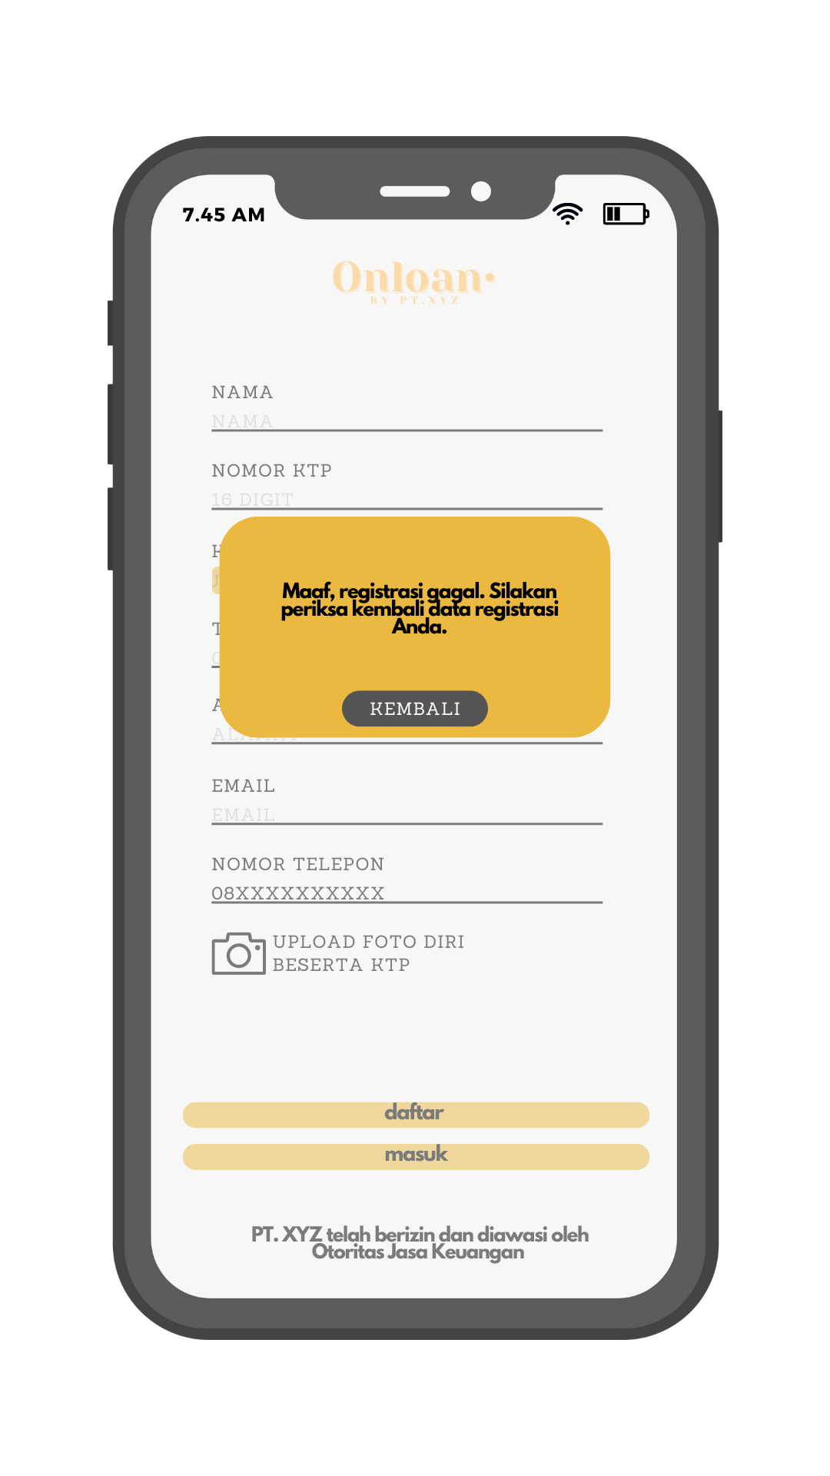
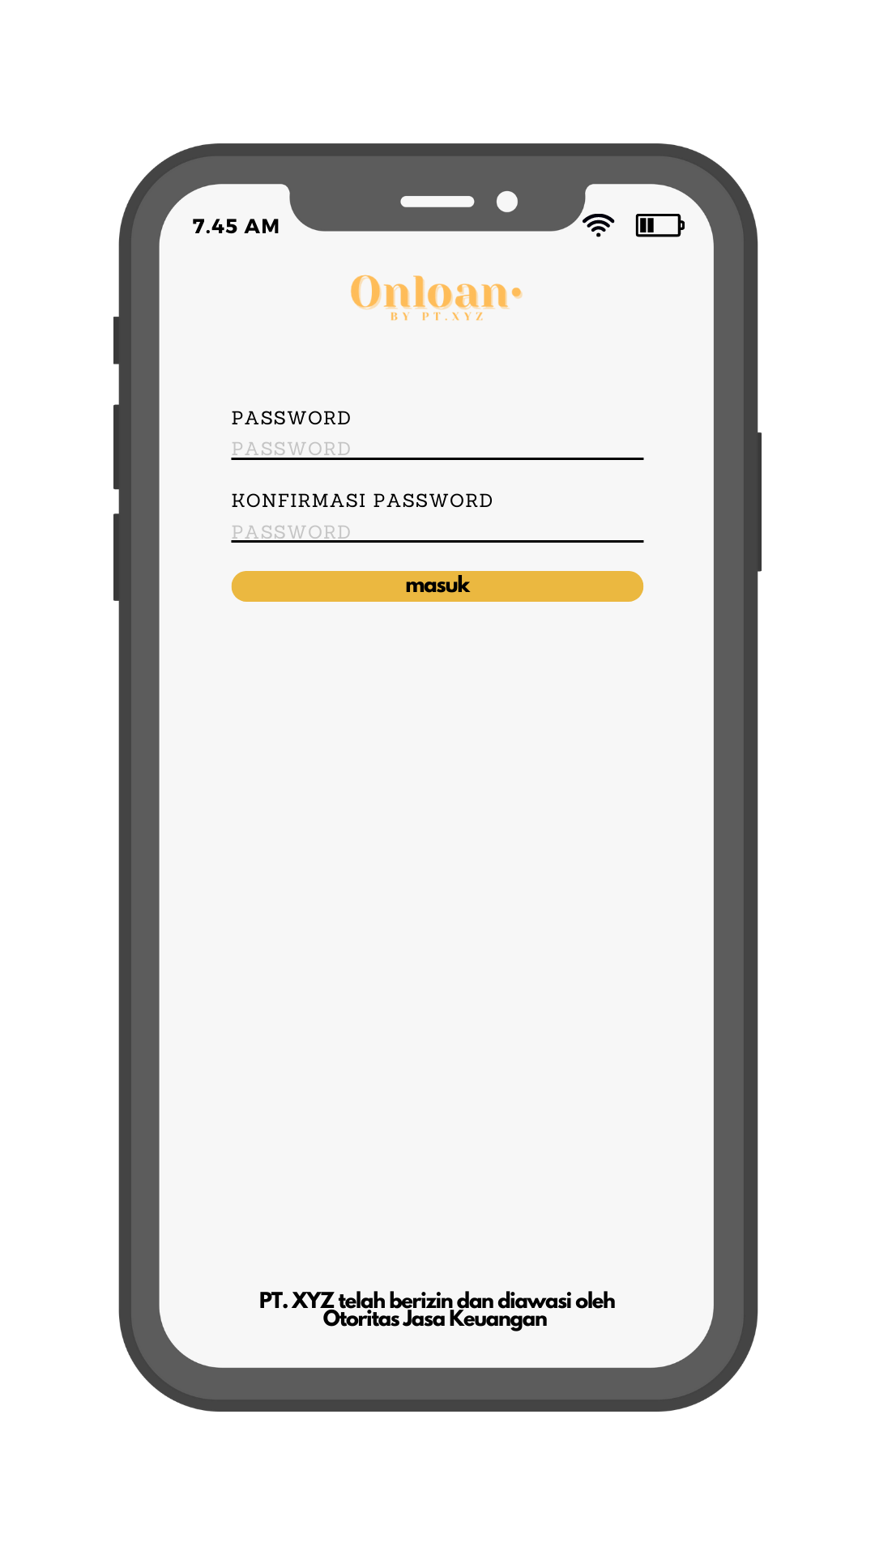
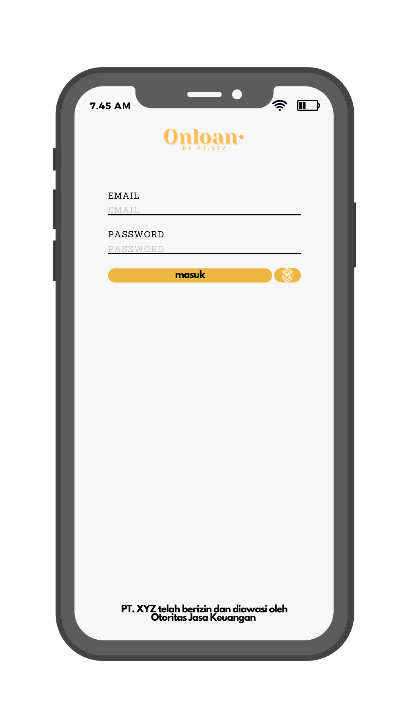
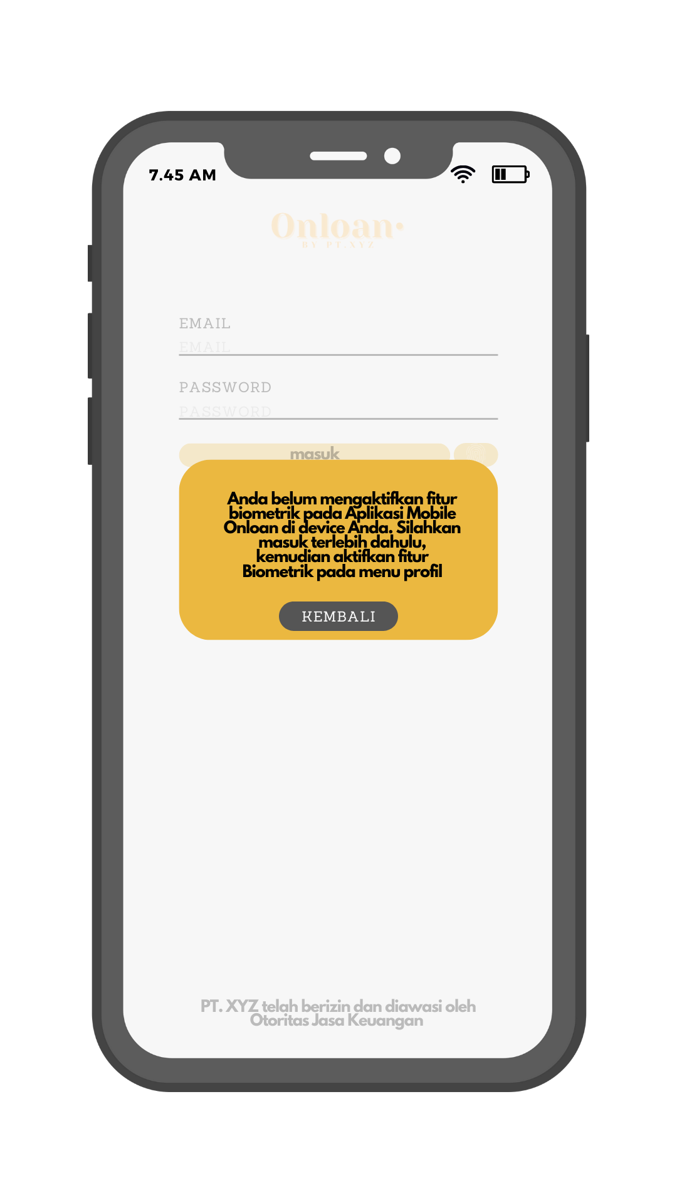
Screen Flow
5a. Rgistration failed
5b. Registration succes,
Set password
6. Login page
7a. Login with Biometric
Failed

Slide 6
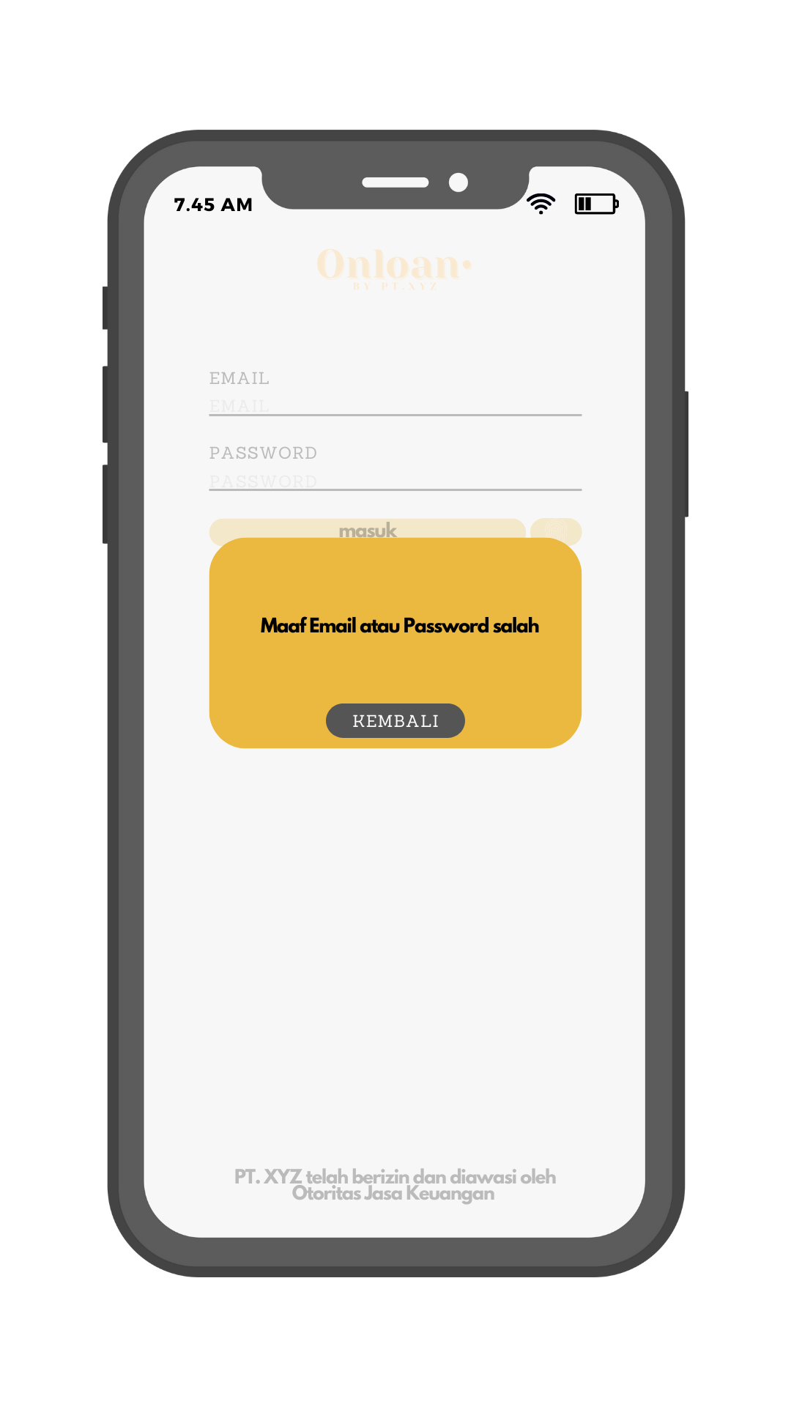
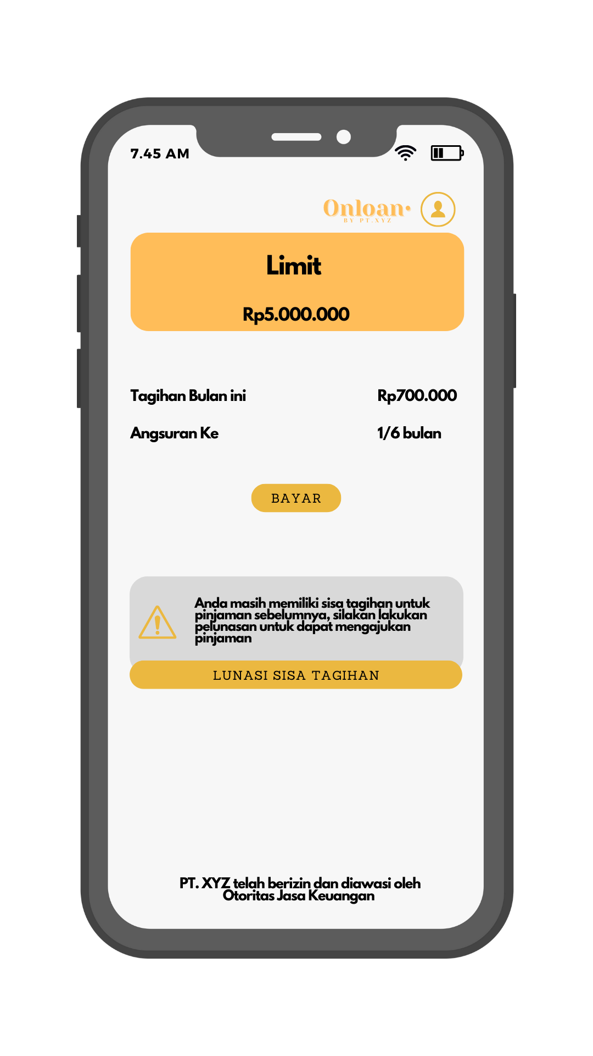
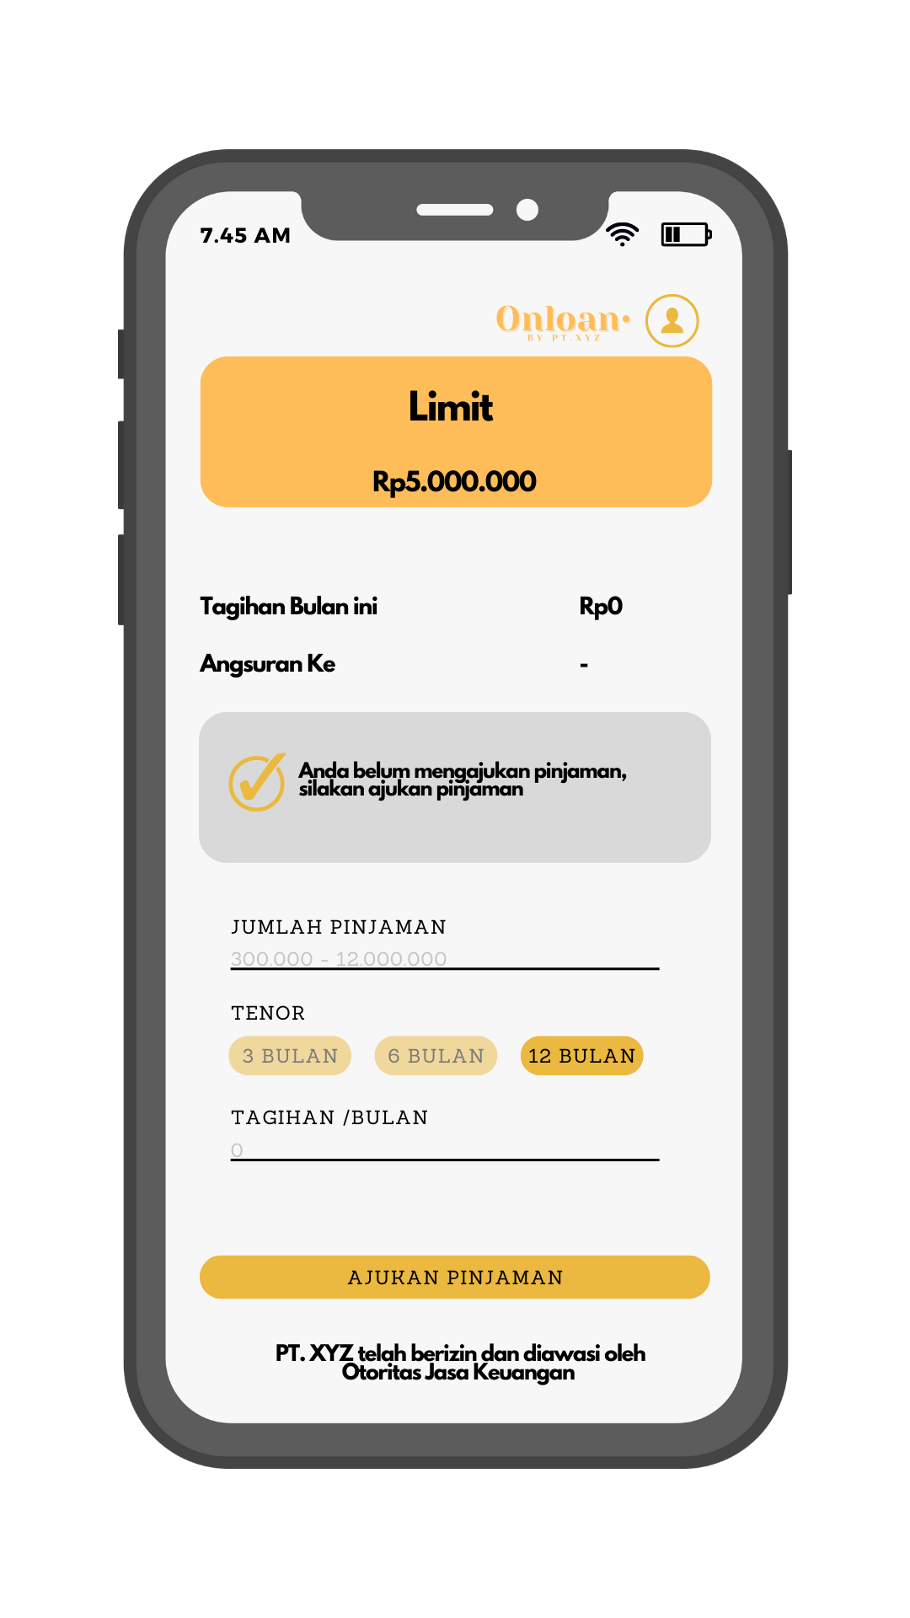
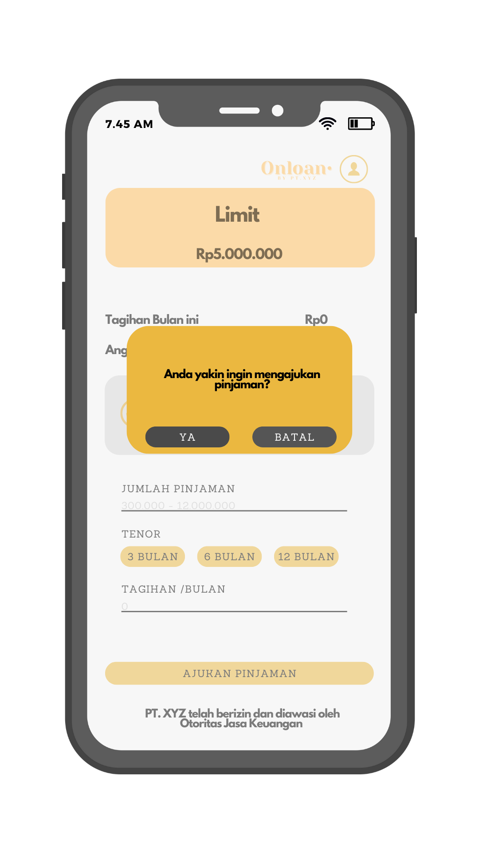
Screen Flow
7b. Login with
Password failed
8. Dashboard with
Loan remaining
9. Dashboard with 0
Loan Remaining
10. Consent page

Slide 7
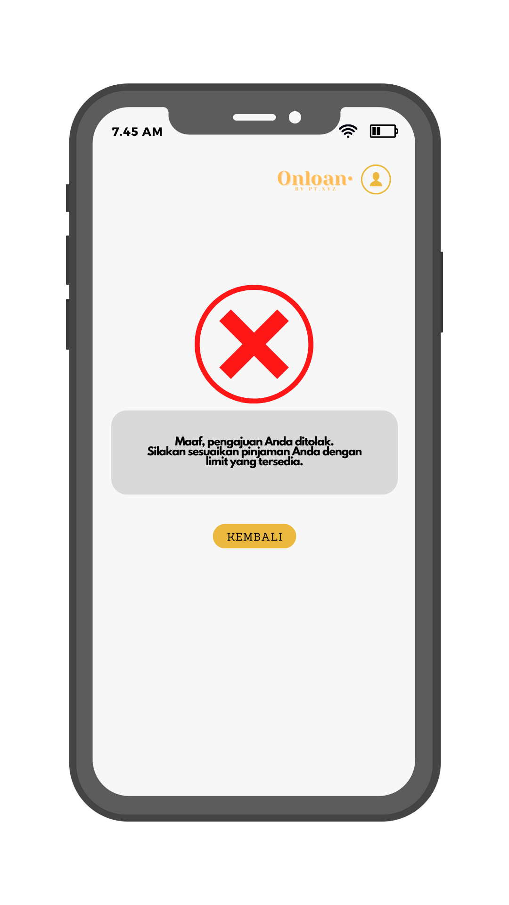
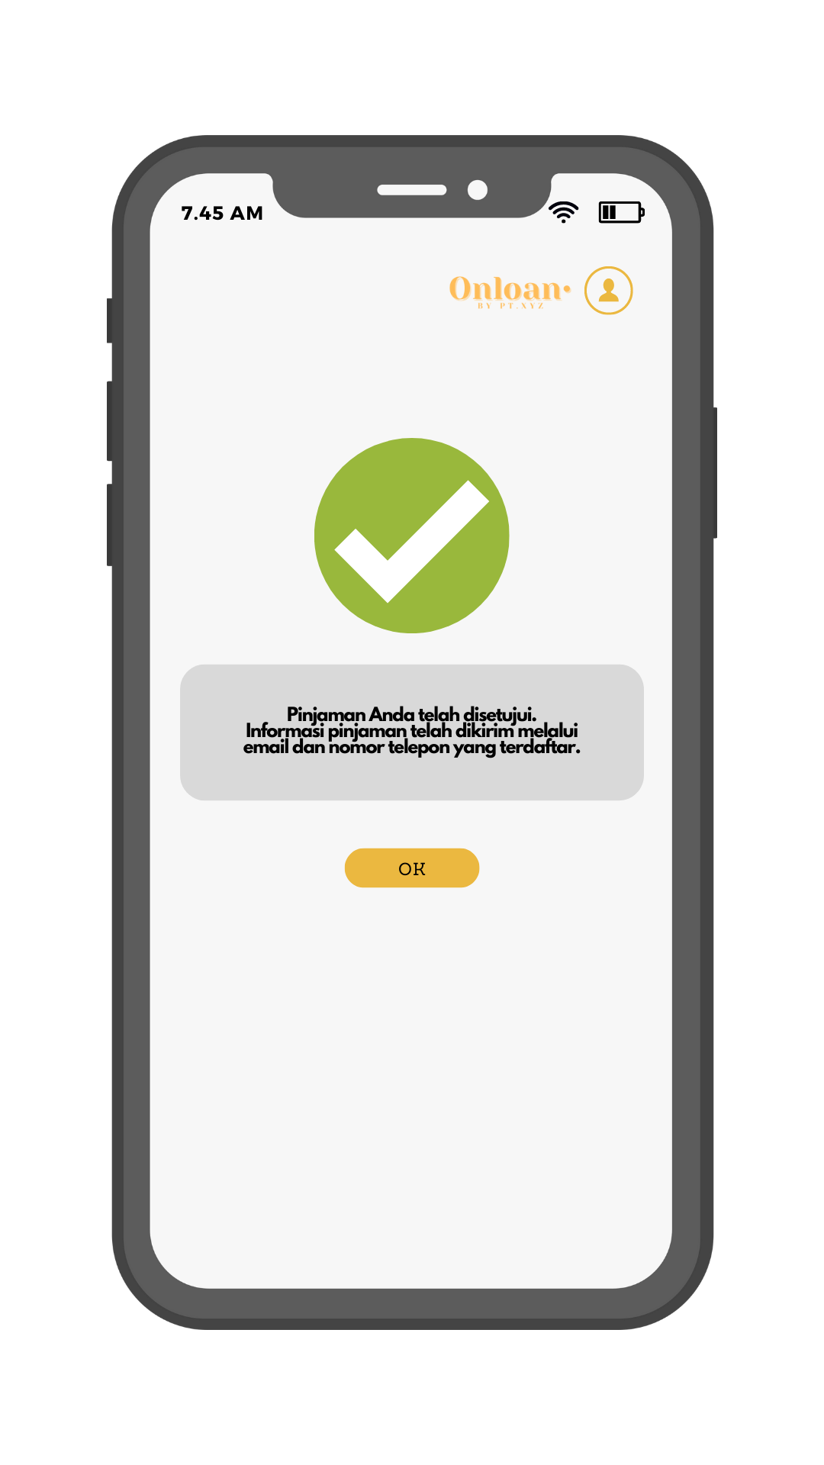
Screen Flow
11. Submission Failed
12. Submission Success

Slide 8
Screen Flow Enable Login with Biometric

Slide 9
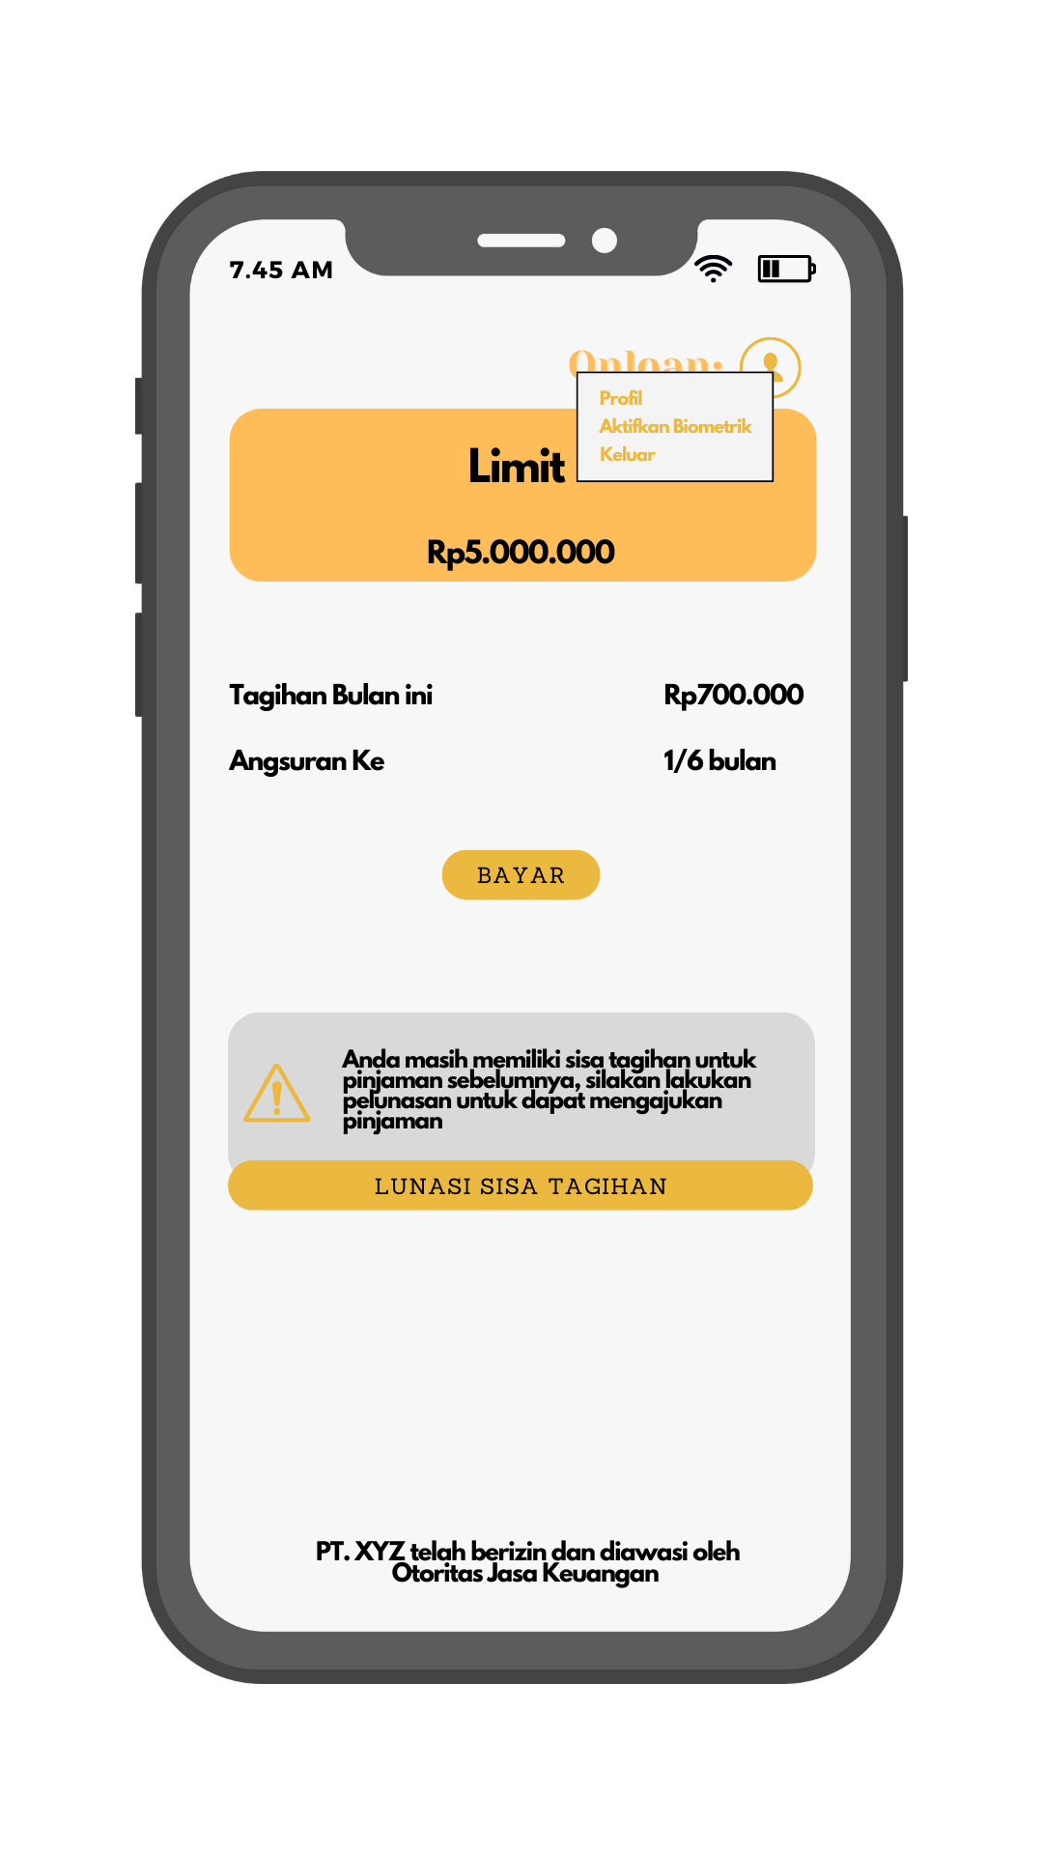
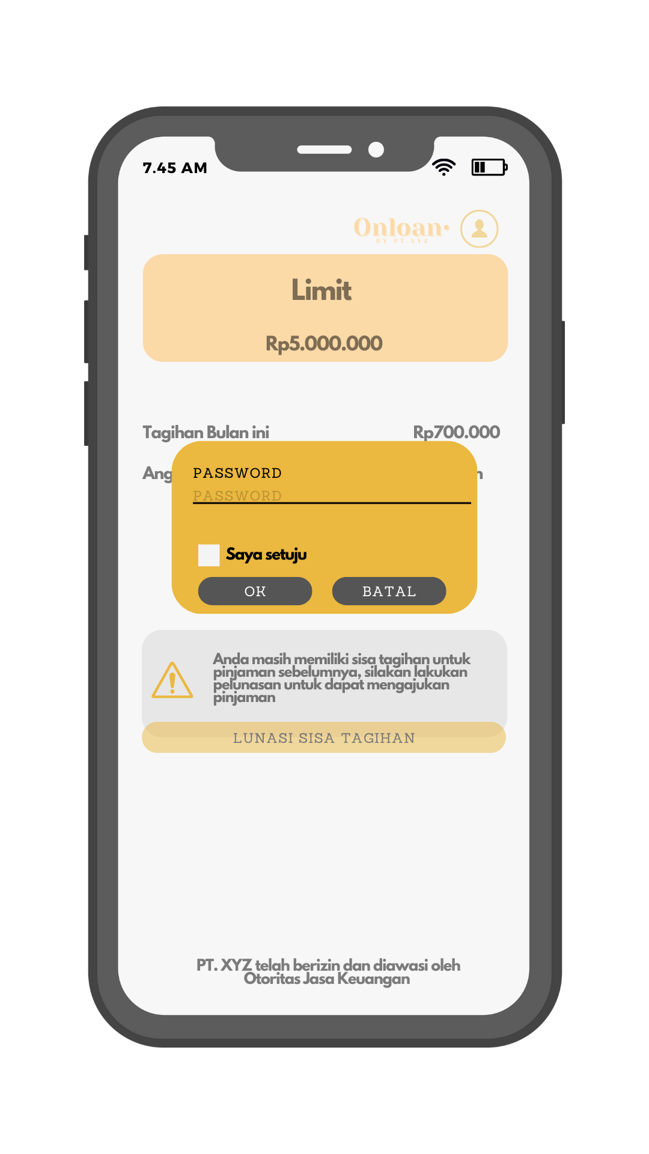
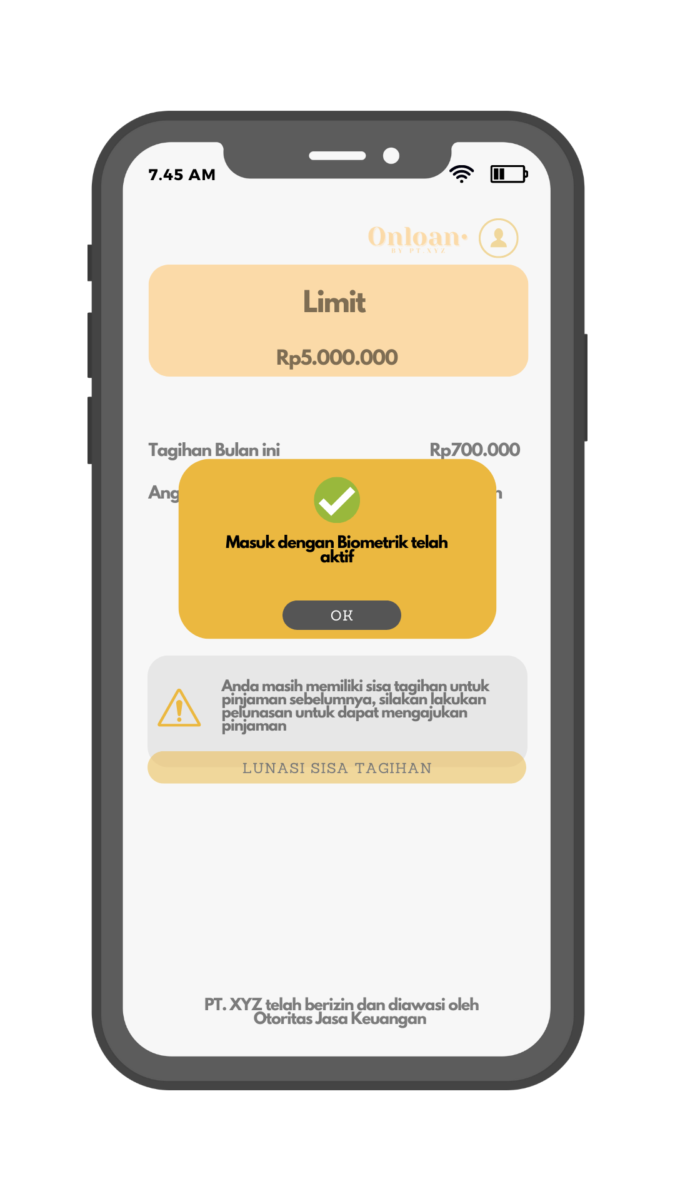
Screen Flow
1. Profile menu
2. Enable login with
Biometric
3. Login with Biometric
actived

Slide 10
Screen Behavior Registration to Submission

Slide 11
Landing page
User can fill-in loan application amount
Toggle radio with color when User choose loan tenor
Automatically filled by calculation of loan installment
Button to go to registration page
Button to go to login page

Slide 12
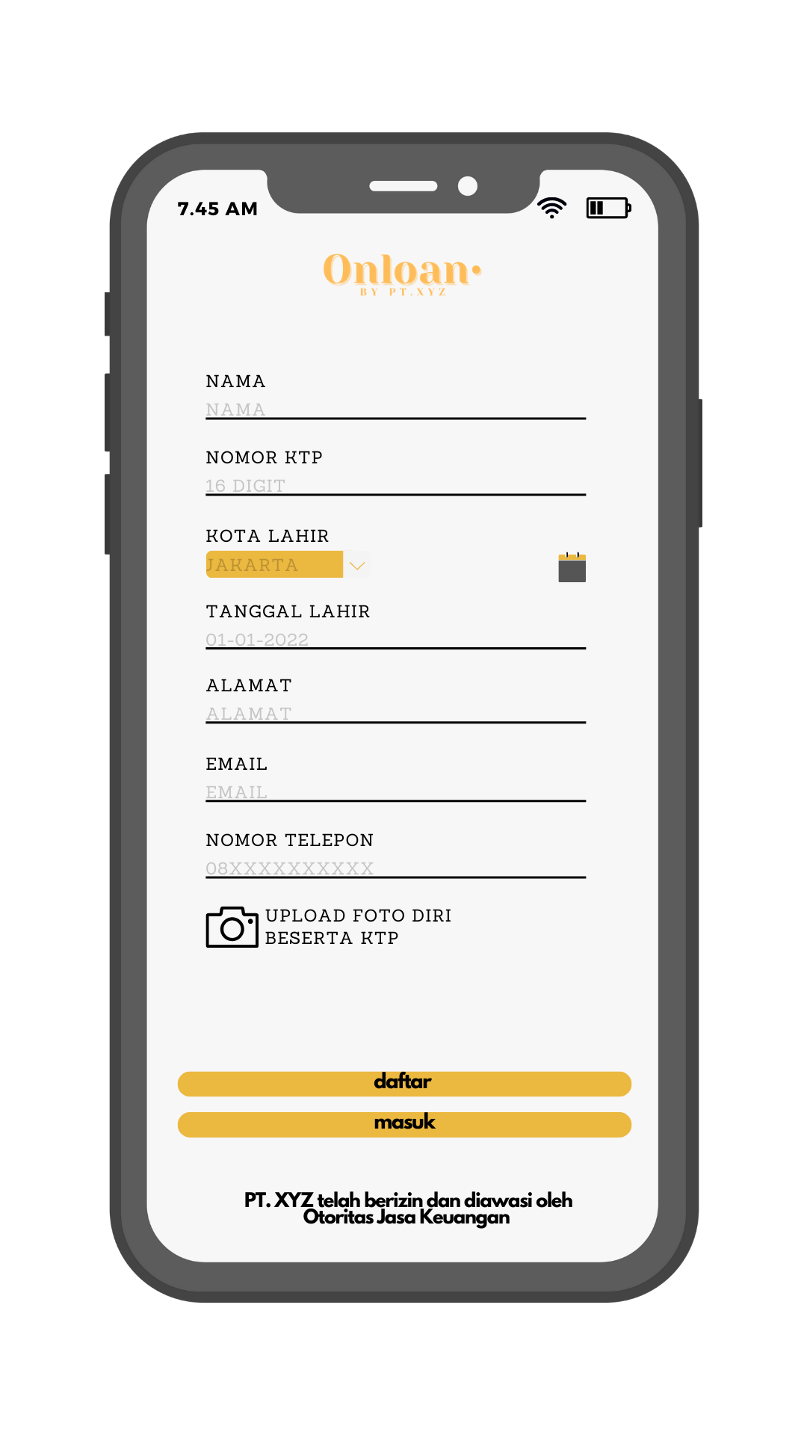
Registration Page
User can fill-in with name
User can fill-in with KTP ID number
User can choose dropdown list of City of Birth
User can choose calendar of DOB
User can fill-in with address
User can fill-in with email
User can fill-in with phone number
Button to open camera
Button to go to set password page
Button to go to login page

Slide 13

Camera screen to upload self photo with KTP
Button to capture photo

Slide 14
Registration failed
Button to back to registration page

Slide 15
Registration failed
User can fill-in with password
User can fill-in with password
Button to go to Login page

Slide 16
Login page
User can fill-in with email
User can fill-in with password
Button to login with biometric to Dashboard
Button to login with password to Dashboard

Slide 17
Login with biometric failed
Button to back to login page

Slide 18
Login with password failed
Button to back to login page

Slide 19
Dashboard – with loan remaining
Show remaining loan, loan installment billing and tenor remaining
Button to pay loan installment
Button to pay off loan remaining

Slide 20
Dashboard – with 0 loan remaining
Show remaining loan, loan installment billing and tenor remaining
User can fill-in loan application amount
Toggle radio with color when User choose loan tenor
Automatically filled by calculation of loan installment
Button to apply loan submission

Slide 21
Dashboard – with 0 loan remaining
Button to back to login page
Button to agree loan submission

